Slide 1
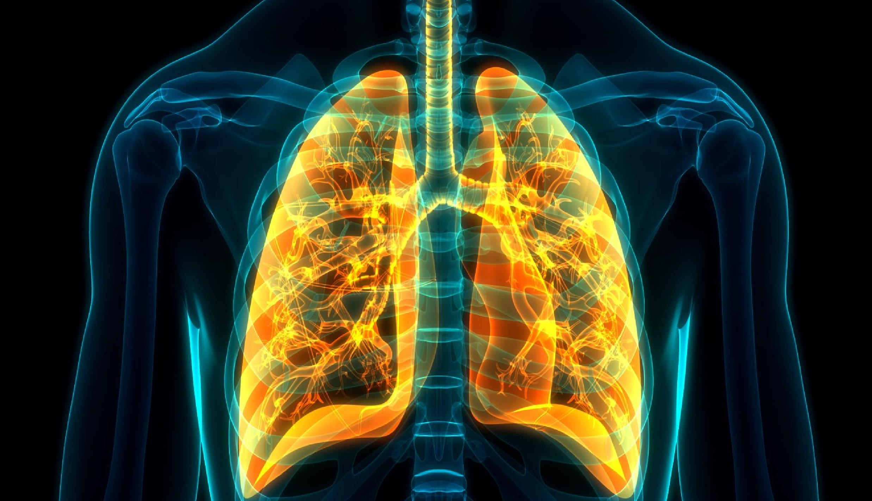
National Lung Cancer Audit
State of the Nation Report 2023
For patients in England 2021 & Wales 2020-2021

Slide 2
This slide set has been created to help NHS organisations:
Present the findings from the NLCA 2022 State of the Nation Report 2023 at local meetings
Review how their services and outcomes compare against other NHS trusts / local health boards and against national figures
Figures from your NHS organisation can be found in the Data Viewer for the 2023 Annual Report and added to the slides where indicated.
Instructions for each slide are in the notes section.
Annual Report & Data Viewer: www.lungcanceraudit.org.uk/quality-improvement/
Notes:
This slide may be deleted prior to presentation,

Slide 3
Patient Characteristics
PATIENT CHARACTERISTIC | TRUST | CANCER ALIANCE | NATIONAL
 | Number (% among known) | Number (% among known) | Number (% among known)
SMOKING STATUS
Never smoked | 3 (6.38) | 163 (8.77) | 1,476 (8.68)
Current / Ex-smoker | 44 (93.62) | 1,695 (91.23) | 15,529 (91.32)
Unknown | 52 | 1,776 | 17,473
ETHNICITY
White | 83 (87.37) | 3,166 (89.38) | 29,938 (89.59)
Mixed | 5 (5.26) | 111 (3.13) | 801 (2.4)
Asian/Asian British | 4 (4.21) | 138 (3.9) | 1,047 (3.13)
Black/Black British | 2 (2.11) | 79 (2.23) | 822 (2.46)
Other | 1 (1.05) | 48 (1.36) | 808 (2.42)
Unknown | 4 | 92 | 1,062
IMD QUINTILE
1 (most deprived) | 22 (22.22) | 1,190 (32.75) | 9,055 (26.26)
2 | 33 (33.33) | 746 (20.53) | 7,385 (21.42)
3 | 17 (17.17) | 679 (18.68) | 6,859 (19.89)
4 | 20 (20.2) | 602 (16.57) | 6,016 (17.45)
5 (least deprived) | 7 (7.07) | 417 (11.47) | 5,163 (14.97)
IMD = Index of Multiple Deprivation
Notes:
Delete example table
Select your trust on data viewer
Copy and paste table 5a

Slide 4
Patient Characteristics
PATIENT CHARACTERISTIC | TRUST | CANCER ALIANCE | NATIONAL
 | Number (% among known) | Number (% among known) | Number (% among known)
TYPE OF LUNG CANCER
Non-small cell | 44 (44.44) | 1,893 (52.09) | 19,345 (56.11)
Small cell | 14 (14.14) | 286 (7.87) | 2,541 (7.37)
Carcinoid | 1 (1.01) | 55 (1.51) | 466 (1.35)
Not assessed (NSCLC) | 40 (40.4) | 1,400 (38.53) | 12,126 (35.17)
STAGE AT DIAGNOSIS
Stage I | 7 (8.05) | 667 (20.66) | 6,756 (22.78)
Stage II | 3 (3.45) | 250 (7.74) | 2,353 (7.93)
Stage IIIA | 5 (5.75) | 376 (11.64) | 3,639 (12.27)
Stage IIIB/C | 10 (11.49) | 307 (9.51) | 2,771 (9.34)
Stage IV | 62 (71.26) | 1,629 (50.45) | 14,140 (47.68)
Unknown | 12 | 405 | 4,819
PERFORMANCE STATUS
0 | 15 (16.85) | 579 (18.55) | 6,083 (21.34)
1 | 23 (25.84) | 1,026 (32.86) | 9,188 (32.24)
2 | 17 (19.1) | 677 (21.68) | 5,626 (19.74)
3 | 17 (19.1) | 626 (20.05) | 5,835 (20.47)
4 | 17 (19.1) | 214 (6.85) | 1,770 (6.21)
Unknown | 10 | 512 | 5,976
Notes:
Delete example table
Select your trust on data viewer
Copy and paste table 5b

Slide 5
Key Recommendations

Slide 6
R1: Aim to achieve high levels of data completeness in the Rapid Cancer Registration Dataset
 | Target | National Completeness | Trust Completeness | Cancer Alliance Completeness
TMN Stage | 90% | 86% | XX | XX
Performance Status | 90% | 83% | XX | XX
Morphology | 75% | 65% | XX | XX
Basis of Diagnosis | 90% | 90% | XX | XX
Access to LCNS | 90% | 59% | XX | XX
Smoking Status | 90% | 49% | XX | XX
Notes:
Select your trust and the data completeness indicator from drop down menu
Go to table 1
Complete the last 2 columns of the table with your local results for each indicator

Slide 7
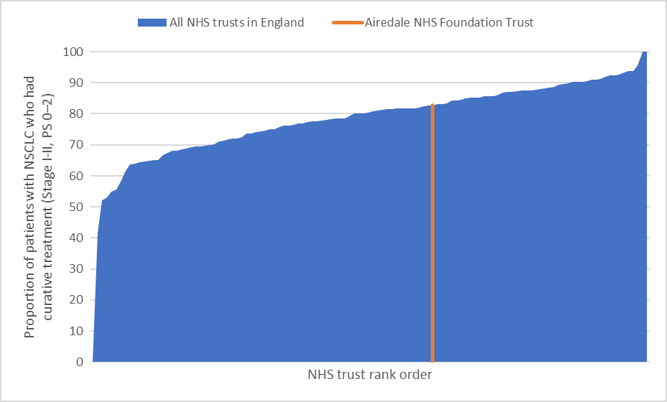
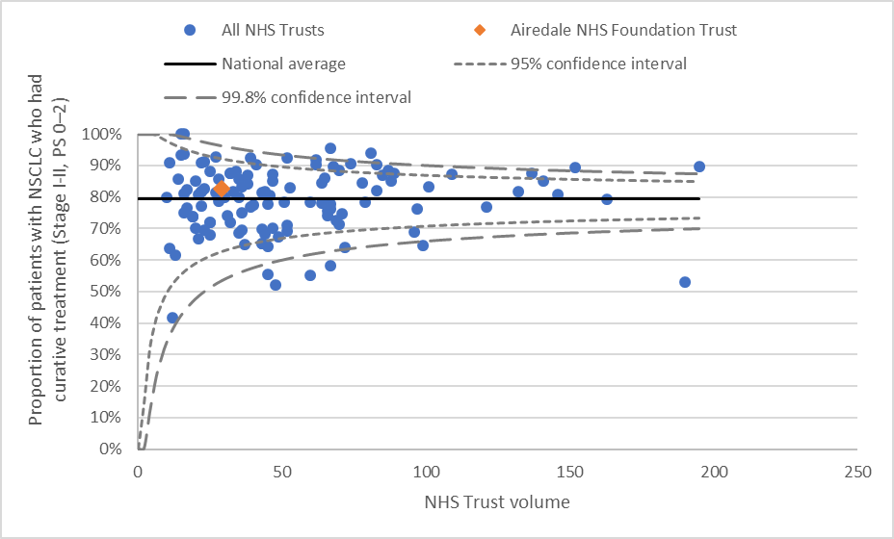
R2: Ensure at least 85% of patients with stage I/II PS 0–2 NSCLC undergo curative-intent treatment
 |  | Denominator (N) |  | UNADJUSTED RESULTS |  | ADJUSTED RESULTS
 |  |  |  | Proportion (%) | Rank (national) | Proportion (%) | Rank (national)
Airedale NHS Foundation Trust |  | 29 |  | 82.76 | 73 | 75.9 | 38
West Yorkshire and Harrogate cancer alliance |  | 436 |  | 90.37 | 20 | 81.4 | 15
NATIONAL RESULTS |  | 6,364 |  | 79.31 | NA | NA | NA
 |  |  |  | * NRA: not risk adjusted; **NR: not reported, as denominator <10
Table 2 here
Figure 2 here
Figure 3 here
Notes:
Delete example table and figures
Select your trust and the indicator from drop down menu
Copy and paste table 2
Copy and ‘paste as picture’ figure 2
Copy and ‘paste as picture’ figure 3

Slide 8
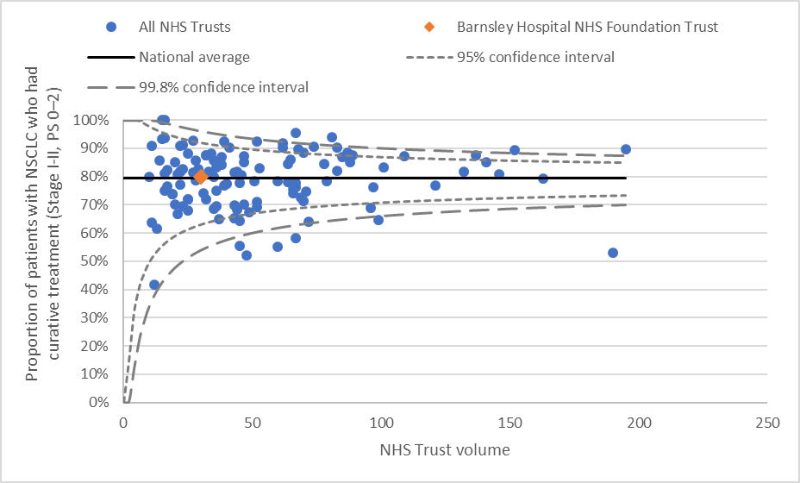
R3: Ensure at least 70% of patients with NSCLC stage IIIB-IV and PS 0-1 receive systemic anti-cancer therapy
Nice guidance
 |  | Denominator (N) |  | UNADJUSTED RESULTS |  | ADJUSTED RESULTS
 |  |  |  | Proportion (%) | Rank (national) | Proportion (%) | Rank (national)
Barnsley Hospital NHS Foundation Trust |  | 30 |  | 80.00 | 56 | 92.9 | 117
South Yorkshire and Bassetlaw cancer alliance |  | 289 |  | 83.74 | 17 | 84.5 | 19
NATIONAL RESULTS |  | 6,364 |  | 79.31 | NA | NA | NA
 |  |  |  | * NRA: not risk adjusted; **NR: not reported, as denominator <10
Table 2 here
Figure 2 here
Figure 3 here
Notes:
Delete example table and figures
Select your trust and the indicator from drop down menu
Copy and paste table 2
Copy and ‘paste as picture’ figure 2
Copy and ‘paste as picture’ figure 3

Slide 9
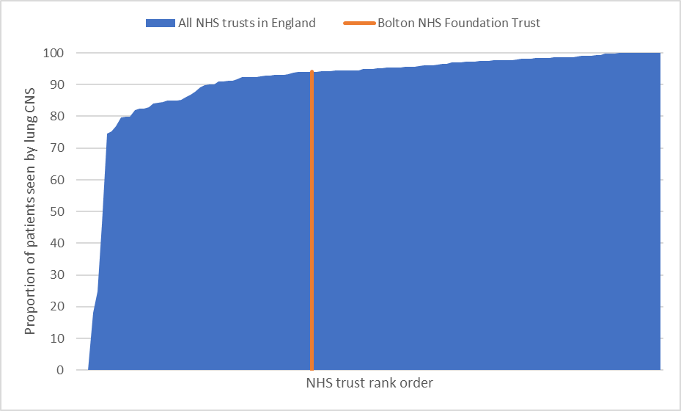
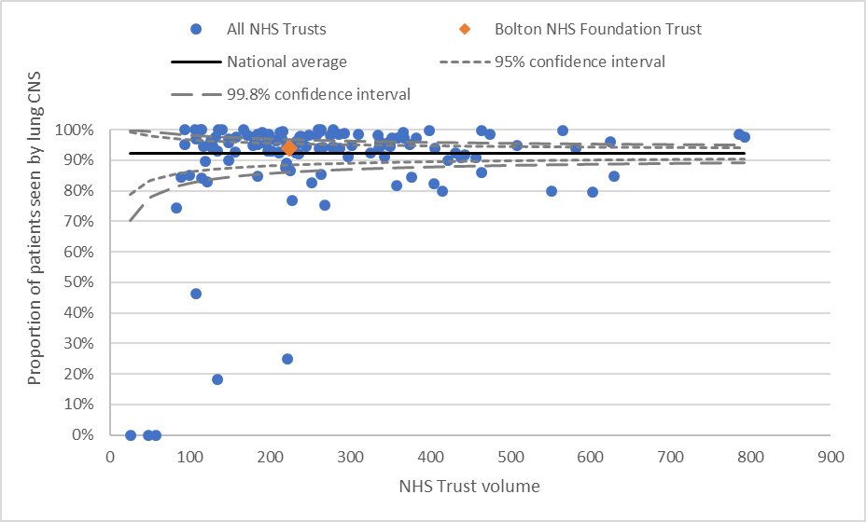
R4: Ensure at least 90% of lung cancer patients are seen by a lung cancer clinical nurse specialist at diagnosis
 |  | Denominator (N) |  | UNADJUSTED RESULTS |  | ADJUSTED RESULTS
 |  |  |  | Proportion (%) | Rank (national) | Proportion (%) | Rank (national)
Bolton NHS Foundation Trust |  | 224 |  | 94.08 | 51 | NRA* | NRA*
Greater Manchester cancer alliance |  | 2,264 |  | 97.51 | 20 | NRA* | NRA*
NATIONAL RESULTS |  | 34,478 |  | 92.31 | NA | NA | NA
 |  |  |  | * NRA: not risk adjusted; **NR: not reported, as denominator <10
Table 2 here
Table 2 here
Figure 2 here
Figure 3 here
Notes:
Delete example table and figures
Select your trust and the indicator from drop down menu
Copy and paste table 2
Copy and ‘paste as picture’ figure 2
Copy and ‘paste as picture’ figure 3

Slide 10
Other Indicators
nlca@rcseng.ac.uk

Slide 11
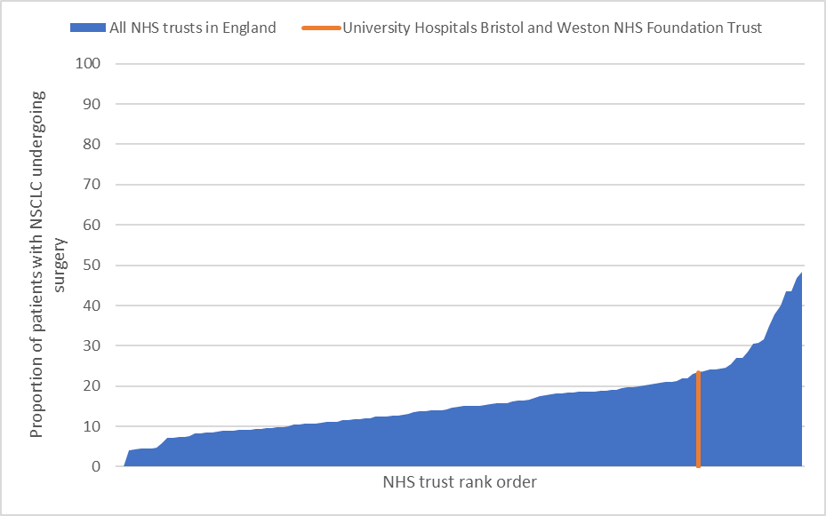
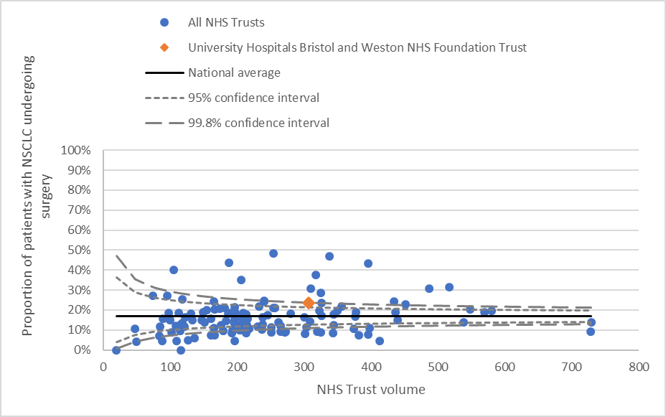
Patients with NSCLC undergoing Surgery >17%
 |  | Denominator (N) |  | UNADJUSTED RESULTS |  | ADJUSTED RESULTS
 |  |  |  | Proportion (%) | Rank (national) | Proportion (%) | Rank (national)
University Hospitals Bristol and Weston NHS Foundation Trust |  | 307 |  | 23.45 | 107 | 21.1 | 100
Somerset, Wiltshire, Avon & Gloucestershire cancer alliance |  | 1,419 |  | 14.94 | 5 | 16.6 | 7
NATIONAL RESULTS |  | 31,471 |  | 16.81 | NA | NA | NA
 |  |  |  | * NRA: not risk adjusted; **NR: not reported, as denominator <10
Table 2 here
Figure 2 here
Figure 3 here
Notes:
Delete example table and figures
Select your trust and the indicator from drop down menu
Copy and paste table 2
Copy and ‘paste as picture’ figure 2
Copy and ‘paste as picture’ figure 3

Slide 12
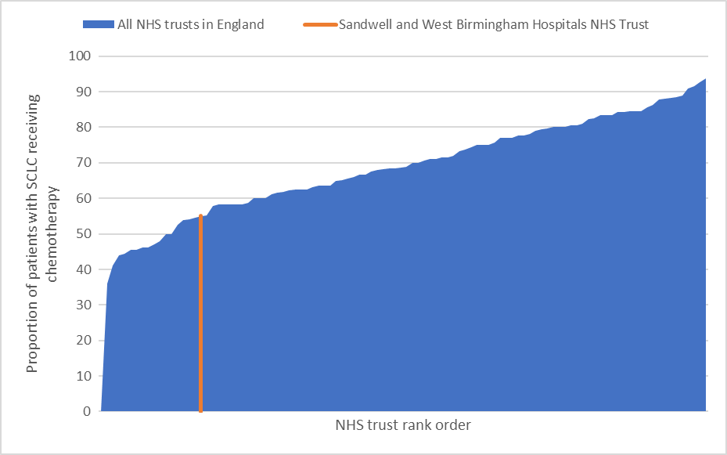
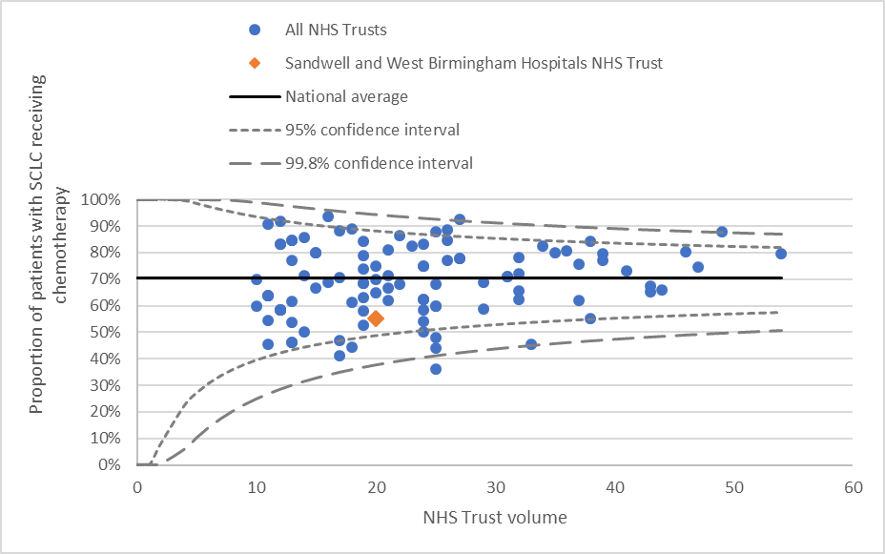
Patients with SCLC receiving chemotherapy >70%
 |  | Denominator (N) |  | UNADJUSTED RESULTS |  | ADJUSTED RESULTS
 |  |  |  | Proportion (%) | Rank (national) | Proportion (%) | Rank (national)
Sandwell and West Birmingham Hospitals NHS Trust |  | 20 |  | 55.00 | 17 | 49.8 | 9
West Midlands cancer alliance |  | 286 |  | 65.38 | 5 | 64.6 | 6
NATIONAL RESULTS |  | 2,541 |  | 70.44 | NA | NA | NA
 |  |  |  | * NRA: not risk adjusted; **NR: not reported, as denominator <10
Table 2 here
Figure 2 here
Figure 3 here
Notes:
Delete example table and figures
Select your trust and the indicator from drop down menu
Copy and paste table 2
Copy and ‘paste as picture’ figure 2
Copy and ‘paste as picture’ figure 3

Slide 13
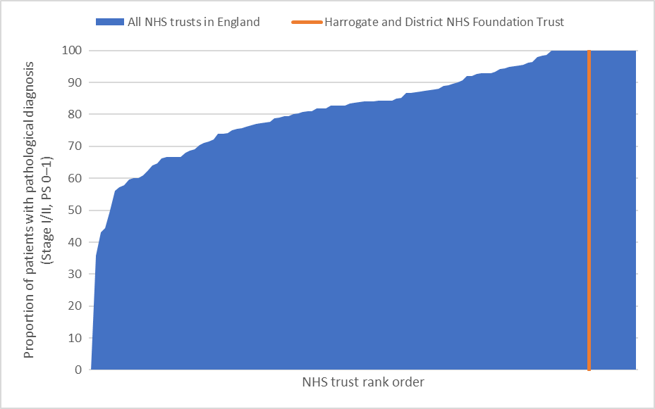
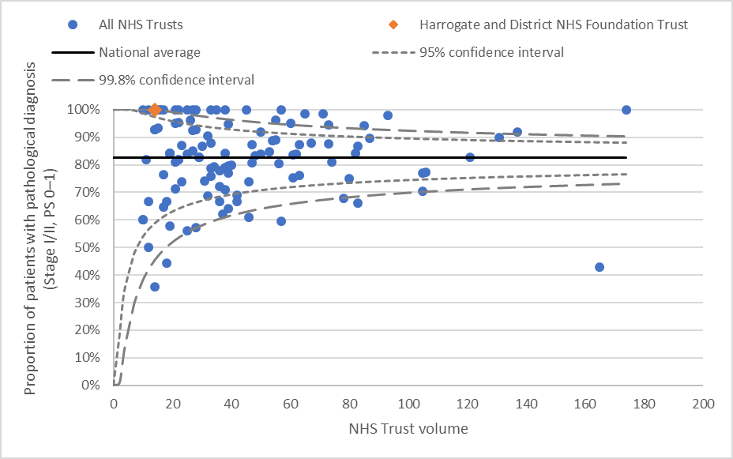
Proportion of patients with pathological diagnosis (Stage I/II, PS 0–1)
 |  | Denominator (N) |  | UNADJUSTED RESULTS |  | ADJUSTED RESULTS
 |  |  |  | Proportion (%) | Rank (national) | Proportion (%) | Rank (national)
Harrogate and District NHS Foundation Trust |  | 14 |  | 100.00 | 106 | NRA* | NRA*
Humber, Coast and Vale cancer alliance |  | 202 |  | 69.31 | 2 | NRA* | NRA*
NATIONAL RESULTS |  | 5,175 |  | 82.57 | NA | NA | NA
 |  |  |  | * NRA: not risk adjusted; **NR: not reported, as denominator <10
Table 2 here
Figure 2 here
Figure 3 here
Notes:
Delete example table and figures
Select your trust and the indicator from drop down menu
Copy and paste table 2
Copy and ‘paste as picture’ figure 2
Copy and ‘paste as picture’ figure 3

Slide 14
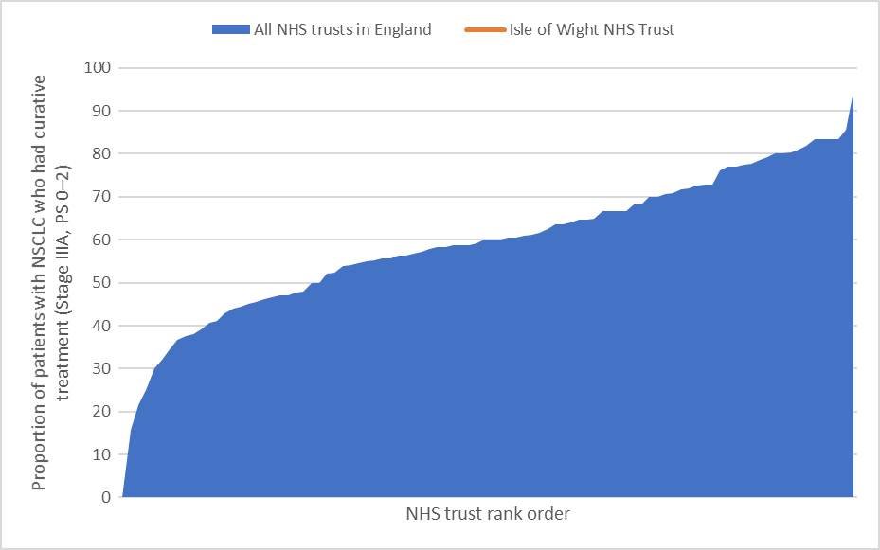
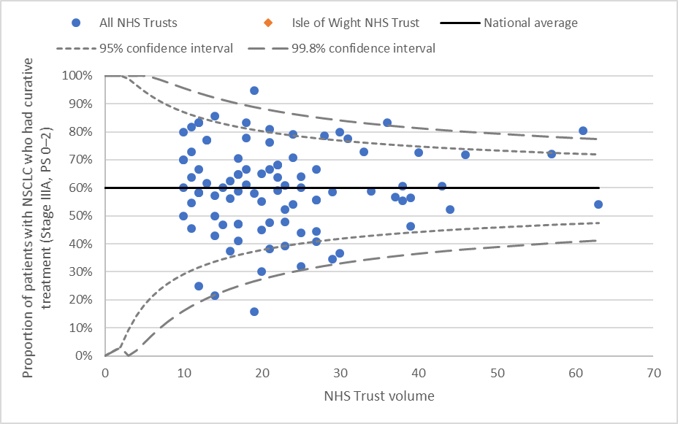
Proportion of patients with NSCLC who had curative treatment (Stage IIIA, PS 0–2)
 |  | Denominator (N) |  | UNADJUSTED RESULTS |  | ADJUSTED RESULTS
 |  |  |  | Proportion (%) | Rank (national) | Proportion (%) | Rank (national)
Isle of Wight NHS Trust |  | NR** |  | NR** | NR** | NR** | NR**
Wessex cancer alliance |  | 110 |  | 57.27 | 10 | 58.2 | 9
NATIONAL RESULTS |  | 2,314 |  | 60.07 | NA | NA | NA
 |  |  |  | * NRA: not risk adjusted; **NR: not reported, as denominator <10
Table 2 here
Figure 2 here
Figure 3 here
Notes:
Delete example table and figures
Select your trust and the indicator from drop down menu
Copy and paste table 2
Copy and ‘paste as picture’ figure 2
Copy and ‘paste as picture’ figure 3

Slide 15
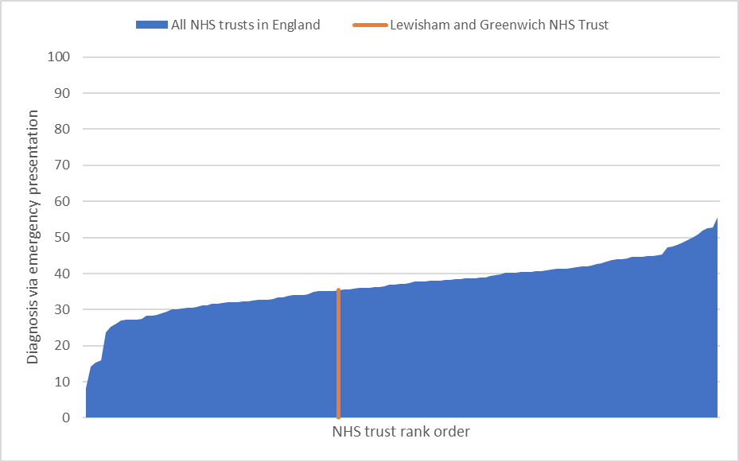
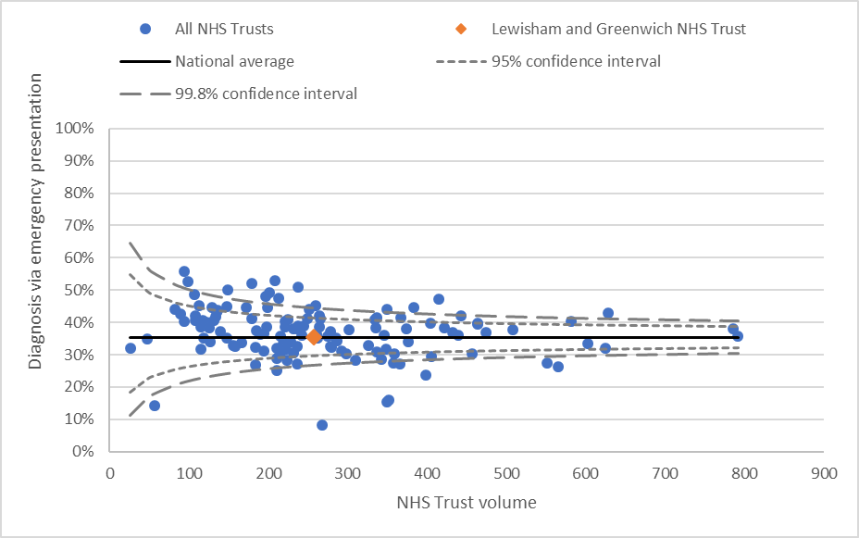
Diagnosis via Emergency Presentation
 |  | Denominator (N) |  | UNADJUSTED RESULTS |  | ADJUSTED RESULTS
 |  |  |  | Proportion (%) | Rank (national) | Proportion (%) | Rank (national)
Lewisham and Greenwich NHS Trust |  | 258 |  | 35.41 | 51 | 33.4 | 38
South East London cancer alliance |  | 945 |  | 30.18 | 1 | 29.0 | 1
NATIONAL RESULTS |  | 34,478 |  | 35.42 | NA | NA | NA
 |  |  |  | * NRA: not risk adjusted; **NR: not reported, as denominator <10
Table 2 here
Figure 2 here
Figure 3 here
Notes:
Delete example table and figures
Select your trust and the indicator from drop down menu
Copy and paste table 2
Copy and ‘paste as picture’ figure 2
Copy and ‘paste as picture’ figure 3

Slide 16
What are we doing well?
1
Enter Text Here
2
Enter Text Here
3
Enter Text Here
Notes:
Identify 3 areas of good practice locally

Slide 17
Where do we need to Improve?
1
Enter Text Here
2
Enter Text Here
3
Enter Text Here
Notes:
Identify 3 areas that require development locally

Slide 18
Local Action Plan
1
Enter Text Here
2
Enter Text Here
3
Enter Text Here
Notes:
Suggest 3 key action points to address areas in need for development locally
You may find the NLCA action plan template helpful for this

